Slide 1
LECTURE 4
UE4 Gameplay Framework Classes

Slide 2
LECTURE GOALS AND OUTCOMES
The goals of this lecture are to
Identify the Gameplay Framework classes
Present the Game Mode class and its default classes
Explain the Player Controller and Player State classes
Present the Pawn class and some subclasses
Introduce the Game Instance and Game Session classes
By the end of this lecture you will be able to
Identify the common classes of the Gameplay Framework
Understand the relationship between the Game Mode and Game State
Understand the relationship between the Player Controller and Player State
Know how to possess a Pawn using a Controller
Draw simple information using the HUD class

Slide 3
COMMON CLASSES
Actor Component
Scene Component
Player Controller
When creating a Blueprint, you will be presented with a list of classes commonly used as the Blueprint parent class. These common classes are part of the Gameplay Framework and are used to represent players, characters, controllers, and game rules.
The image on the right shows the hierarchy of the common classes. The arrow indicates that the class on the right is inheriting from the class on the left. There is a base class in Unreal called the Object class.
Object
Controller
AI Controller
Actor
Game Mode
Pawn
Character

Slide 4
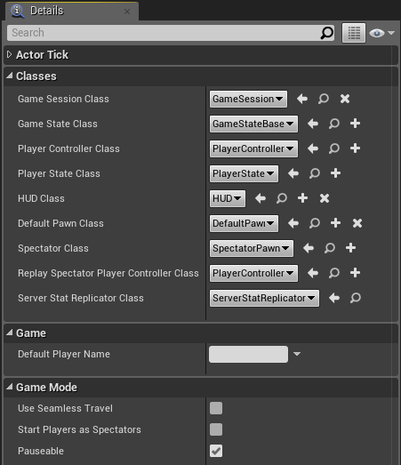
GAME MODE
The Game Mode class is used to define the rules of the game. The Game Mode also specifies the default classes that will be used for the creation of Pawn, Player Controller, Game State, HUD, and other classes, as seen in the image on the right.
Each Level can have a different Game Mode. If a Game Mode is not specified for the Level, it will use the Game Mode that has been set for the project.
In a multiplayer game, the Game Mode exists only on the server and is not replicated to the clients.

Slide 5
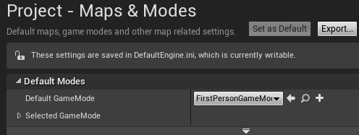
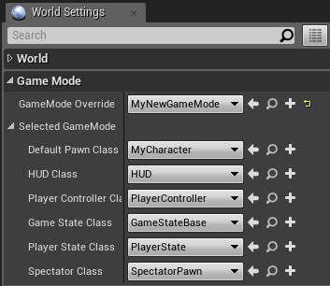
ASSIGNING A GAME MODE
To specify the default Game Mode of a project, go to Edit > Project Settings... in the Level Editor and in the Project category select the Maps & Modes option. Choose the Game Mode in the Default GameMode property’s drop-down, as seen in the top image on the right.
To specify the Game Mode of a Level, click the Settings button in the Level Editor and choose the World Settings option. Choose the Game Mode in the GameMode Override property’s drop-down, as seen in the bottom image.
The Game Mode of a Level overrides the default Game Mode of the project.

Slide 6
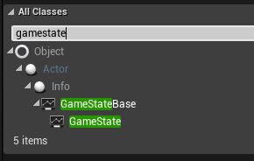
GAME STATE
The Game State class is used to keep track of the variables that represent the current state of the game, and it is shared with all clients in a multiplayer game.
The basic idea is that a Game Mode defines the rules on the server, whereas the Game State manages the information that changes in the game and needs to be sent to the clients.
To use a new Blueprint based on the Game State class, you must assign your custom Game State class to the Game State Class parameter of the Game Mode.
The Game State class extends the Game State Base class and adds some multiplayer functionality.

Slide 7
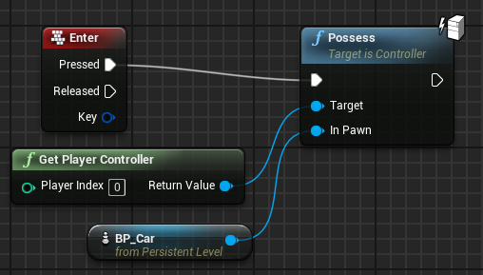
PLAYER CONTROLLER
The Controller class has two main subclasses. The Player Controller class is used by human players, and the AI Controller class uses artificial intelligence to control the Pawn.
Pawn and Character classes only receive input events if they are being possessed by a Player Controller.
The Pawn class being possessed by a Player Controller can be changed in-game. The image on the right is from a Level Blueprint and shows the use of the Possess function. In this example, a Player Controller will possess the BP_Car Pawn Actor in the Level when the Enter key is pressed.

Slide 8
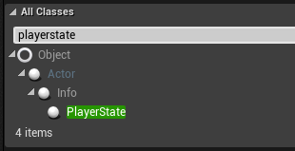
PLAYER STATE
The Player State class is used to keep track of the information of a specific player that needs to be shared with the others clients in a multiplayer game.
The Player Controller exists only on the clients, while the Player State is replicated to all clients from the server.
To use a new Blueprint based on the Player State class, you must set it in the Player State Class parameter of the Game Mode.

Slide 9
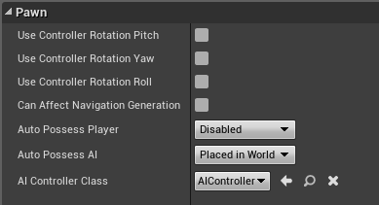
PAWN
Pawns are Actors that can be controlled (possessed) by Controllers (Player or AI).
The Pawn class represents the physical body, and the Controller class represents the brain.
The image on the right shows some of the parameters that are inherited from the Pawn class. The Pawn class can use the rotation values of the Controller that is possessing it.
Other attributes indicate how the Pawn is possessed by a Controller.

Slide 10
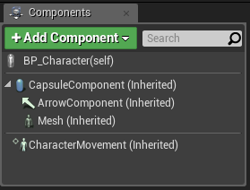
PAWN: CHARACTER
The Character class is a subclass of the Pawn class that is made to represent bipedal characters that can walk, run, jump, swim, and fly. This class already has a set of components to assist in this goal.
The image on the right shows the components present in the Character class.
The CapsuleComponent is used for collision testing.
The ArrowComponent indicates the current direction of the character.
The Mesh component is the Skeletal Mesh that visually represents the character. The animation of the Mesh component is controlled by an animation Blueprint.
The CharacterMovement component is used to define various types of character movement such as walking, running, jumping, swimming, and flying.

Slide 11
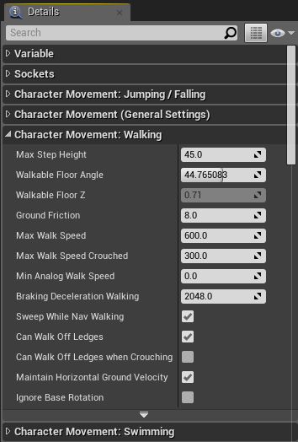
CHARACTER MOVEMENT
The CharacterMovement component is written in C++ and handles movement as well as replication and prediction in multiplayer games.
There are a lot of properties for various types of movements that can be adjusted on the component.

Slide 12
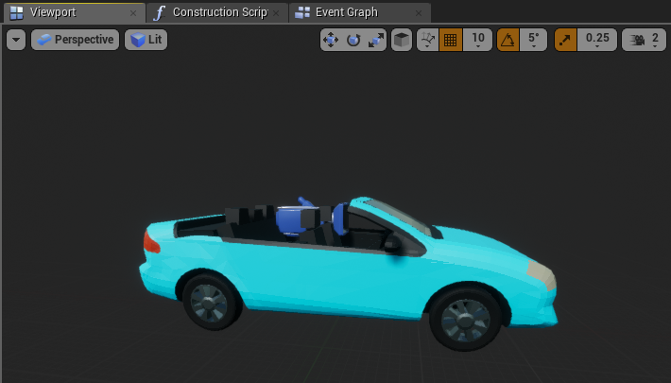
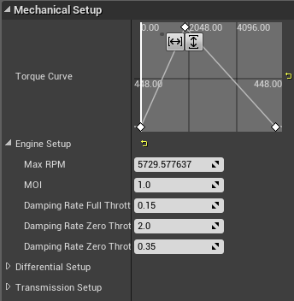
PAWN: VEHICLE
The Wheeled Vehicle class is another example of a subclass of the Pawn class.
It contains a VehicleMovement component that is written in C++ and has code to simulate the behavior of a vehicle. It has many parameters used to define the movement and physics of a vehicle. It can also handle replication and prediction in multiplayer games.
The top image on the right is from the Vehicle template.
The image at the bottom shows some properties of a VehicleMovement component.

Slide 13
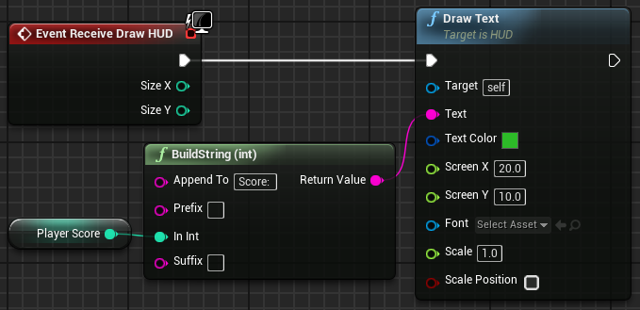
HUD
The HUD class is used to create a heads-up display (HUD), which is a kind of on-screen display that provides quick access to important information. The HUD is used in games to display various information to the players, such as their score, time, energy, and so on.
In Unreal Engine, the HUD class is a base class that contains a Canvas, which is an object on which primitives, such as text and textures, can be drawn.
The HUD class contains an event named “Receive Draw HUD”, which is used to draw the primitives each frame.
The HUD class exists only on each client and does not replicate.

Slide 14
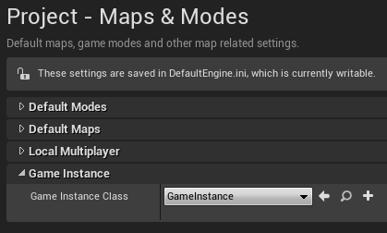
GAME INSTANCE
An instance of the Game Instance class is created at the beginning of the game and is only removed when the game is closed.
All Actors and other objects in a Level are completely destroyed and respawned each time a Level is loaded.
The Game Instance class and the data it contains persist between Levels.
The Game Instance exists only on each client and does not replicate.
To assign the Game Instance class for use in your game, modify the project’s settings by going to Edit > Project Settings > Maps & Modes.

Slide 15
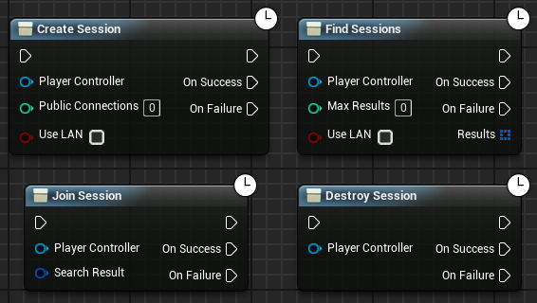
GAME SESSION
Simply stated, a Game Session is an interface for a game running on a server that clients can use to discover and join the game.
The image on the right shows some Blueprint functions that can be used to manage a session.

Slide 16
SUMMARY
This lecture presented the Gameplay Framework classes and the relationship between some common classes.
It showed how to possess a Pawn using a Controller and how to draw simple information using the HUD class.

Slide 17
LABWORK
A Simple Game

Slide 18
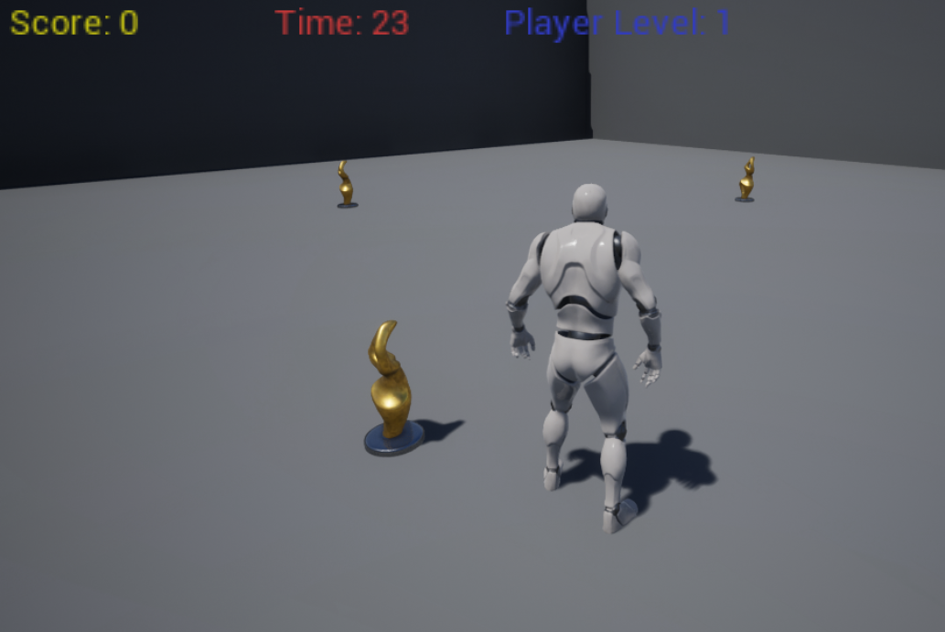
GAME CLASSES
The game created in this lecture is based on the Third Person template. The game uses four main Blueprint classes:
ThirdPersonCharacter: A Pawn subclass that represents the player and is part of the Third Person template. This class is assigned to the Default Pawn Class parameter of the Game Mode.
BP_Statue: An Actor class that represents the statue. It checks for collision with the player and has the logic to change its position periodically.
BP_Guide_GameMode: Controls the state of the game and stores some variables, such as those for time, score, and Level. It also defines the base classes, such as ThirdPersonCharacter.
BP_Guide_HUD: Responsible for drawing the time, score, and Player Level values on the screen.

Slide 19
GAME RULES
The player must collect the small statues that appear on screen before time runs out.
The initial time is set at 30 seconds.
The game is over when there is no time remaining.
For every five statues collected, the Player Level increases and 15 seconds are added to the time.
The player starts at Player Level 1, and the maximum Level a player can reach is Player Level 5.
There are three statues in the scenario that change position periodically.
When a statue appears in a position, it will stay there for a period of time that depends on the current Player Level. The number of seconds it takes a statue to change position is the result of the expression “6 – Level”.
When the player gets a statue, another one is spawned.
The score for a statue collected is determined by the expression “10 x Level”.
The time, score, and Player Level values will be drawn on the screen.

Slide 20
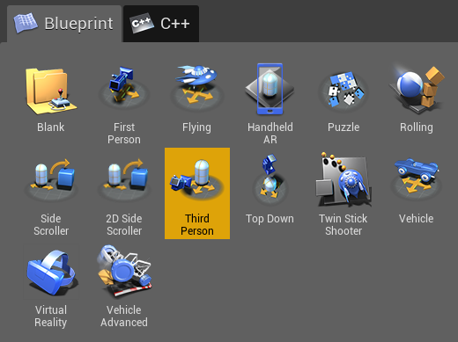
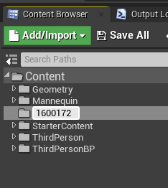
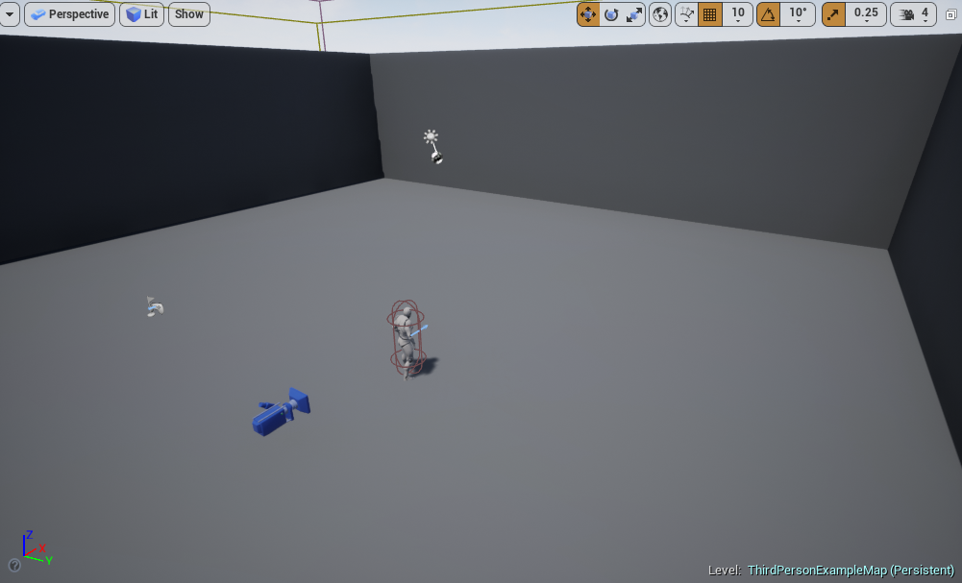
CREATING THE PROJECT
Create a new project using the Third Person template with starter content.
Remove the Static Mesh and Text Render Actors that are in the middle of the scene, leaving only the floor and side walls, as seen in the bottom image on the right.
In the Content Browser, create a new folder with your
<Student Number> that will store all new Blueprints.

Slide 21
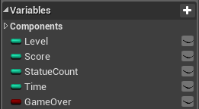
BP_GUIDE_GAMEMODE
Create a new Blueprint class and choose “Game Mode Base” as the parent class. Rename it “BP_Guide_GameMode”.
Create the following Integer variables:
Level: Stores the current Player Level in the game.
Score: Stores the player’s score.
StatueCount: Keeps track of the number of statues collected.
Time: Stores the time remaining until the end of the game.
Create the following Boolean variable:
GameOver: Indicates if the game has ended.

Slide 22
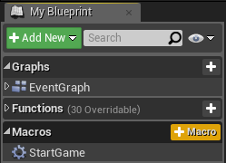
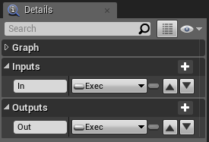
BP_GUIDE_GAMEMODE: START GAME MACRO
In the My Blueprint panel, create a macro named “StartGame”.
This macro is responsible for initializing the variables that control the state of the game.
In the Details panel for the StartGame macro, create an input parameter named “In” and set the type to “Exec”. Create an output parameter named “Out” and set the type to “Exec”.

Slide 23
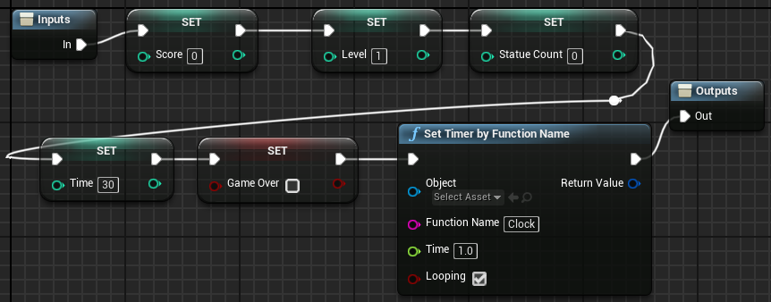
BP_GUIDE_GAMEMODE: START GAME MACRO
The StartGame macro will set the initial values of the variables.
The Set Timer function creates a Timer object that will call a custom event named “Clock” every 1.0 seconds.

Slide 24
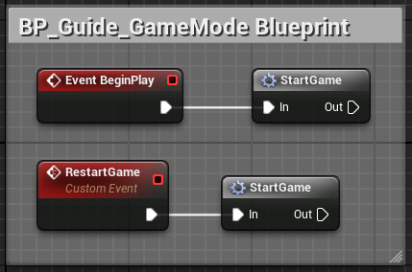

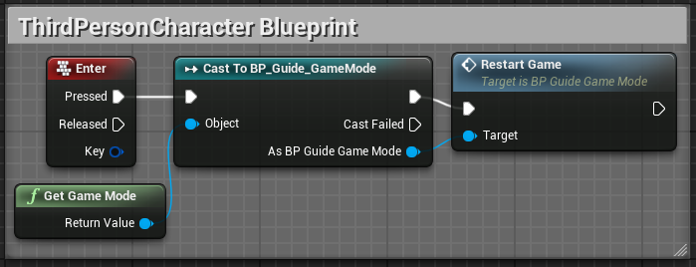
BP_GUIDE_GAMEMODE: USING THE MACRO
The StartGame macro is called from the BeginPlay event in the BP_Guide_GameMode Blueprint.
A custom event named “RestartGame” was created that also calls the StartGame macro.
At this point move the ThirdPersonCharacter to your Student Number folder by dragging it to the folder view from ThirdPersonBP/Blueprints folder.
The RestartGame custom event is called from the ThirdPersonCharacter Blueprint when the player presses the Enter key, as seen in the bottom image on the right.

Slide 25
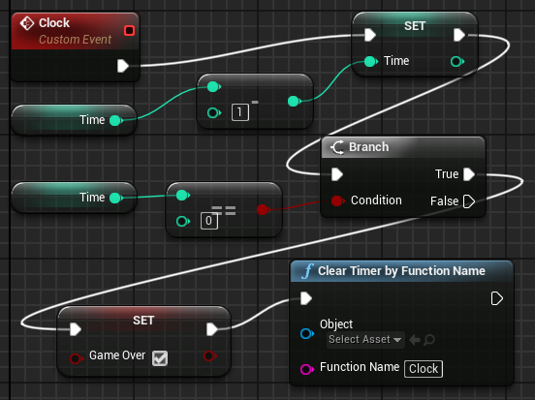
BP_GUIDE_GAMEMODE: CLOCK EVENT
Clock is a custom event that is called every second by the Timer. It has the following responsibilities:
To decrease by “1” the value of the Time variable
To check if the value of the Time variable is “0”; if “true”, to perform the following actions:
Set the value of the Boolean GameOver variable to “true”
Clear the Timer so that it stops calling the Clock event

Slide 26
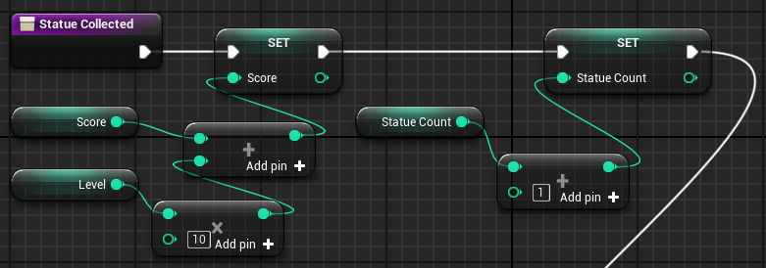
BP_GUIDE_GAMEMODE: STATUE COLLECTED 1/2
“Statue Collected” is a function in BP_Guide_GameMode that is called by the BP_Statue class when the player gets a statue.
The first part of the function performs the following actions:
Adds to the value of the Score variable the points obtained when the player collects a statue, which is calculated with the expression “10 x Level”.
Adds a value of “1” to the StatueCount variable, which stores the number of statues collected.

Slide 27
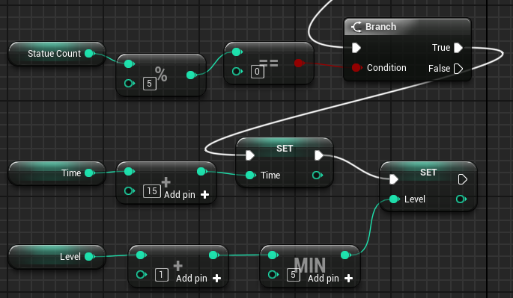
BP_GUIDE_GAMEMODE: STATUE COLLECTED 2/2
The second part of the Statue Collected function does the following:
Tests whether the value of the StatueCount variable is a multiple of 5. If “true”, it performs the following actions:
Adds a value of “15” to the Time variable.
Adds a value of “1” to the Level variable, with the maximum value of the Level variable limited to “5”.
This means that for every five statues collected, the player advances a Level and gets 15 additional seconds of time.
The modulo (%) operator returns the remainder of the division.

Slide 28
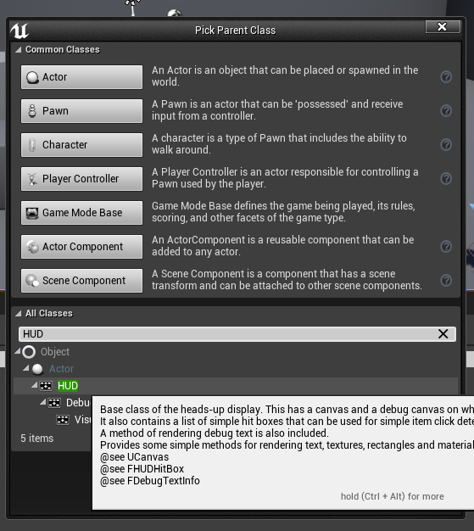
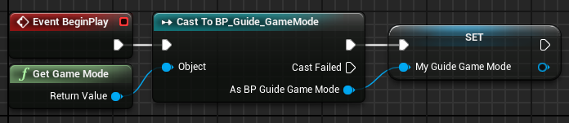
BP_GUIDE_HUD
In BP_GUIDE_HUD:
Create a new Blueprint class and choose “HUD” as the parent class. Name it “BP_Guide_HUD”.
Create a variable named “My_Guide_GameMode” of type “BP_Guide_GameMode Object Reference”.
The image on the right shows the BeginPlay event getting a reference to the Game Mode, casting the reference to BP_Guide_GameMode, and saving that reference in the variable.
This reference will be used to access the variables that will be drawn on the screen.

Slide 29
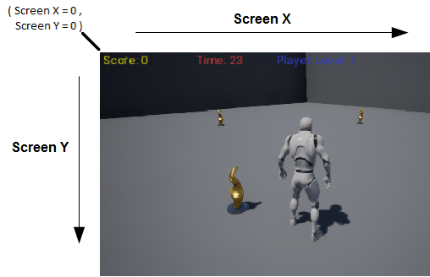
BP_GUIDE_HUD: SCREEN COORDINATES
The only action that will be used to draw in this game is the Draw Text function. This function receives some input values, among them those for two parameters known as “Screen X” and “Screen Y”, which depend on the resolution of the screen. For example, 1280 x 720 is a common resolution.
These values represent the coordinates of the screen on which the text will be drawn. The top left position of the screen is the origin, where the values of Screen X and Screen Y are “0”. The image on the right shows how the values of these two parameters determine where text will be drawn.
The Screen Y value used by the Score, Time, and Level variables is “10”, so the associated text appears at the top of the screen.
The Screen X values used are “10” by the Score variable, “300” by the Time variable, and “550” by the Level variable.

Slide 30
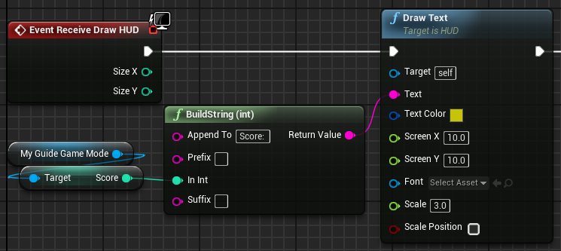
BP_GUIDE_HUD:
RECEIVE DRAW HUD 1/3
To draw on the screen, the Receive Draw HUD event must be added to the Event Graph. This event is available only in Blueprints based on the HUD class.
The Draw Text function of the HUD class is used to print the score on the screen, as shown in the image on the right.
The BuildString (int) function is used to produce a string containing the text “Score:” plus the current value of the Score variable. The resulting string is passed to the Text parameter of the Draw Text function.

Slide 31
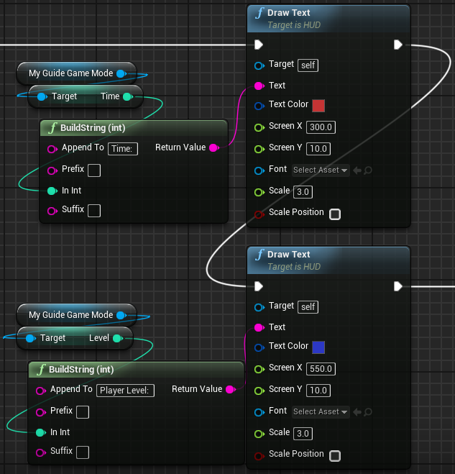
BP_GUIDE_HUD: RECEIVE DRAW HUD 2/3
The setup for drawing text for the Time and Level variables is very similar to that for drawing text for the Score variable.
The only changes in the Draw Text function involve the parameters Text, Text Color, and Screen X.

Slide 32
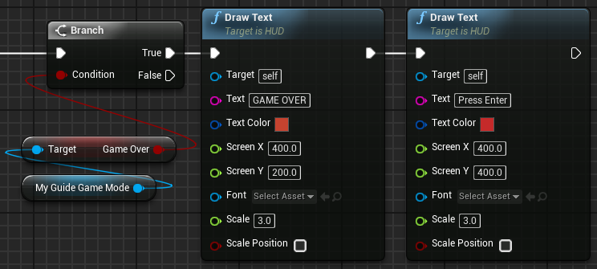
BP_GUIDE_HUD:
RECEIVE DRAW HUD 3/3
The last part of the Receive Draw HUD event tests if the value of the GameOver variable is “true”. If it is, then it draws on the screen the strings “GAME OVER” and “Press Enter”.

Slide 33
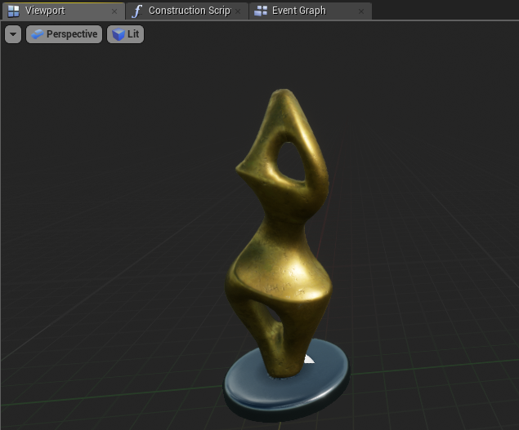
BP_STATUE
Create a new Blueprint class and choose “Actor” as the parent class. Rename it “BP_Statue”.
Add a Static Mesh component. In the Details panel for the Static Mesh component, set the Static Mesh property to “SM_Statue”.
Set the Element 0 property in the Materials category to “M_Metal_Gold”.
Set the Collision Presets property to “OverlapAllDynamic”.
Compile and save your Blueprint class.
Add three instances of the BP_Statue Blueprint to the Level at any location.

Slide 34
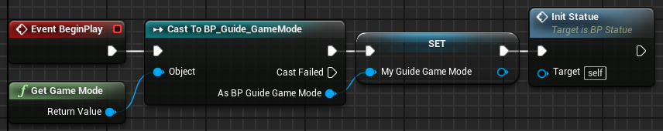
BP_STATUE:
EVENT BEGIN PLAY
The image on the right shows the BeginPlay event getting a reference to the Game Mode, casting the reference to BP_Guide_GameMode, and saving that reference in the variable.
After that, the function InitStatue is called.

Slide 35
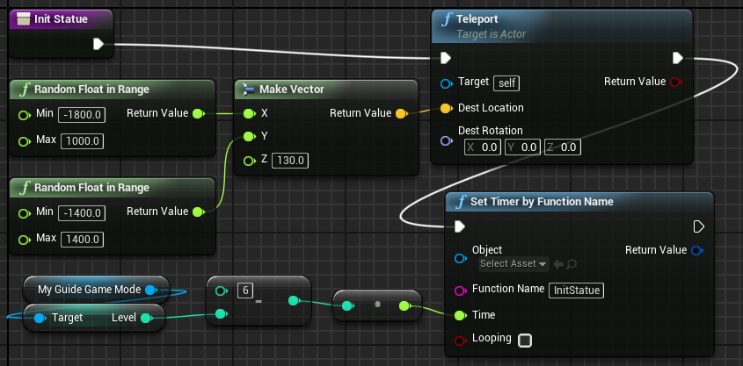
BP_STATUE:
FUNCTION INIT STATUE
In the InitStatue function, there are two main nodes:
Teleport: This node sets a new location for the statue. The location is represented by a vector (X, Y, Z) where the values of the X and Y parameters are random. The minimum and maximum values of the X and Y parameters represent the area of the game.
Set Timer by Function Name: This Timer represents the time in seconds that the statue will take to change position. When this time expires, the InitStatue function is called to set a new position. The value of the Time parameter is the result of the expression “6 – Level”. “Level” is a variable from the My_Guide_GameMode class that represents the Player Level.

Slide 36
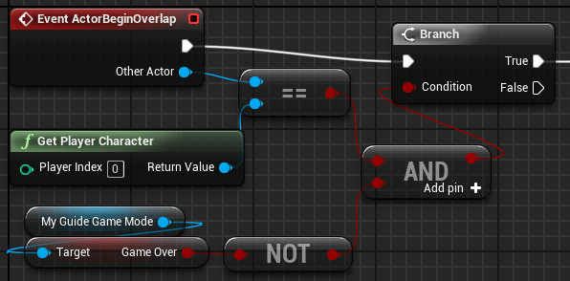
BP_STATUE: ACTOR BEGIN OVERLAP 1/2
The ActorBeginOverlap collision event is triggered when an Actor in the game overlaps the statue.
The value passed to the Condition input parameter of the Branch node is the result of the expression that checks to see if the Actor who is overlapping the statue is the Player Character and if the GameOver variable in the Game Mode is not set to “true”. The statue will be collected only if these two conditions are both true.

Slide 37
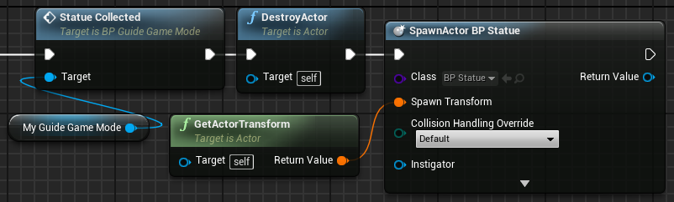
BP_STATUE: ACTOR BEGIN OVERLAP 2/2
If the statue is collected, the Statue Collected function of the My_Guide_GameMode class is called to manage the player’s score and the game Level.
After that, the current statue is destroyed and a new one is created.

Slide 38
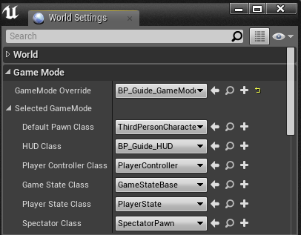
SETTING THE GAME MODE
Open the BP_Guide_GameMode Blueprint and click the Class Defaults button. Set the Default Pawn Class property to “ThirdPersonCharacter” and the HUD Class property to “BP_Guide_HUD”.
In the Level Editor, click the Settings button and choose “World Settings”. In the World Settings panel, set the GameMode Override property to “BP_Guide_GameMode”.
The game is now ready to play.

Slide 39
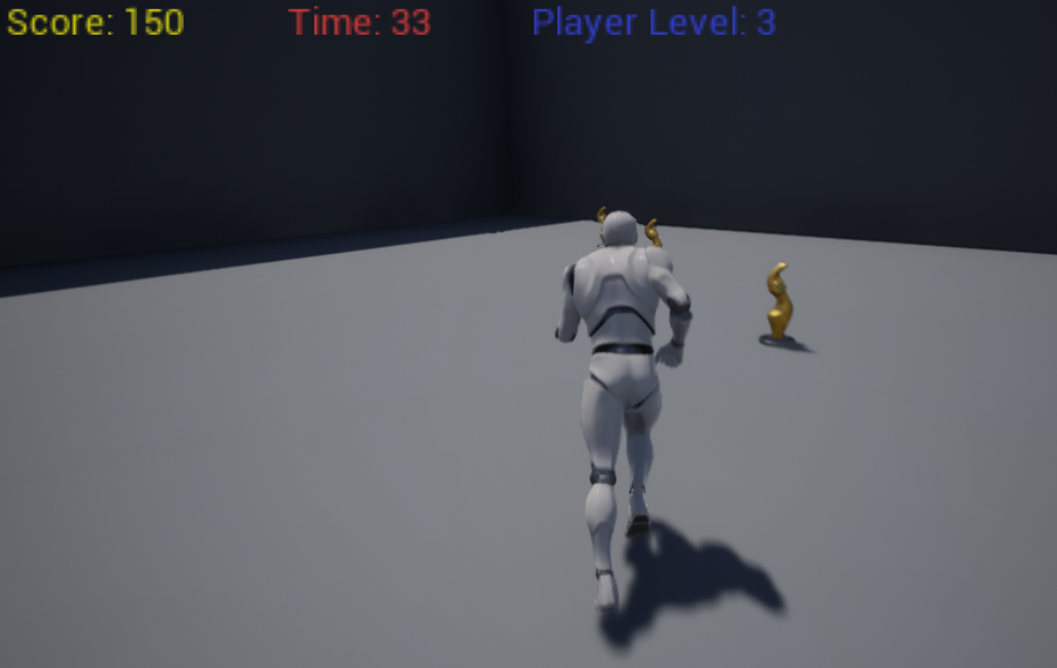
PLAYING THE GAME
If everything is correct, when playing the game, the player will control a character and must get the statues.
There are three statues in the scenario that change position periodically.
When the player overlaps a statue, they will receive a score and the statue will reappear in another location.
There is a countdown, and the game is over when there is no time remaining.
For every five statues collected, the Player Level increases and 15 seconds are added to the time.

Slide 40
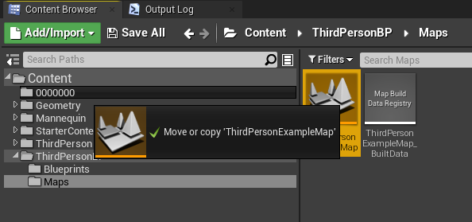
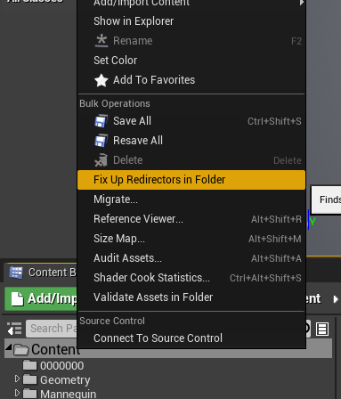
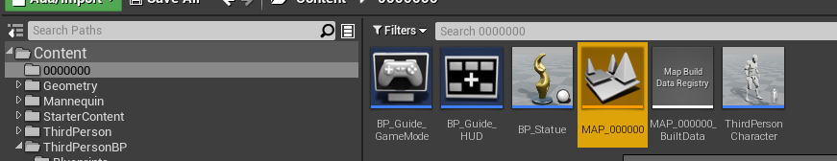
PREPARING THE ASSIGNMENT FILES
1
Lastly move the
1) ThirdpersonExampleMap to your Student Number folder from ThirdpersonBP/Maps folder.
Then rename the map to
2) MAP_<Student Number>
3) LASTLY, Right-Click on Content folder and choose “Fix Up Redirectors in Folder”. This will clean-up any redirectors were created while moving the assets from folder to folder.
...and SAVE ALL!!!
3
2

Slide 41
ASSIGNMENT #1
Introduce new mechanics and rules to the “Simple Game”.

Slide 42
ASSIGNMENT #1
INTRODUCE ONE MAIN AND ONE SECONDARY MECHANIC FOR THE SIMPLE GAME.
Submit your assignment on itslearning explaining the questions below and uploading your final zipped/rarred <student number> folder.
Explain your main and secondary mechanic(s) over the simple game project.
Explain modifications you've made to existing blueprints (Mechanics).
Explain the new set of rule(s) over the simple game project.
Explain modifications you've made to existing blueprints (Rules).
Upload your "Content/<Student Number>" folder with all new and modified blueprint classes.
Do don’t zip your whole project folder and submit it!

Slide 43
SOME EXAMPLES FOR THE MAIN MECHANIC
Sprint/Fast movement tied to some trade-off.
Slowing time to some trade-off
Teleportation tied to some trade-off.
Special kind of statue gives a buff or debuff.
Moving platforms or traps affecting game status.
Flying/Jet pack like mechanic with the addition of 3D movement and spawning of statues
You may think of these if you have no idea at all!
Of course, you are not forced to pick from these!
You’re welcome to consult me during practice hours :)

Slide 44
SOME EXAMPLES FOR THE SECONDARY MECHANIC
New spawning effects, animations for the statues
Visual clues for the mechanics like timers, coloring..etc
Modifications over the game’s main rules.
Obstacles, moving platforms, AI players, traps that do not affect the game’s stats.
Introducing a new type of resource that helps the implementation of the main mechanic.
Auto-collect point/aura for a trade-off.
You may think of these if you have no idea at all!
Of course, you are not forced to pick from these!
Cosmetic changes such as materials, animations do not counted as a secondary mechanic unless they are tied to gameplay and blueprinted.
You’re welcome to consult me during practice hours :)

Slide 45
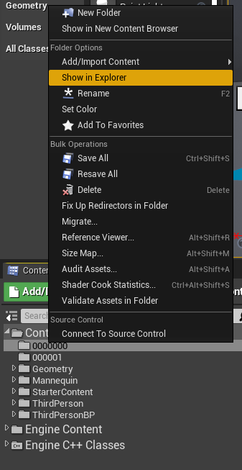
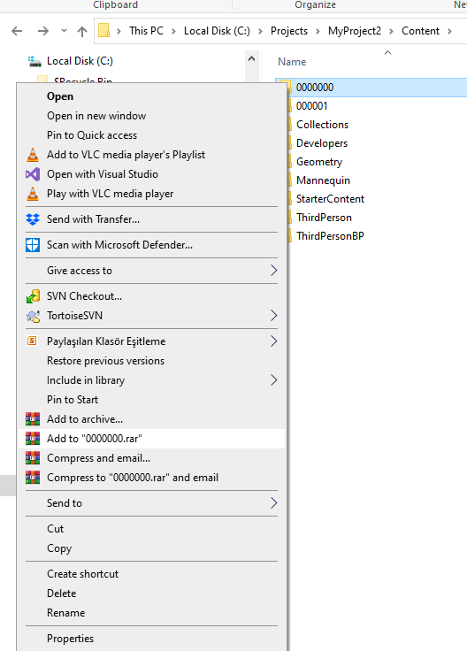
PREPARING THE ASSIGNMENT FILES
For assignment implementation always create your new blueprints under <Student Number> folder.
When you are ready to zip/rar and submit the folder, right click on it and select “Show in Explorer”
RightClick <Student Number> folder and zip/rar it.
Upload into your assignment on itslearning!
DEADLINE:
19th April
18:00

